Slide 1


Capstone Project PGP AIML Pune Feb 20 Presentation on: Ambulance Location Prediction to Serve Future Accident Hotspots
Authors:
Amol Ravatale, Devendra Bharadwaj,
Kushal Thakral, Sanku Lahiri
Great Learning , India

Slide 2
Overview
Introduction – Problem Definition
Solution Workflow
Data Source, Preparation & Pre-Processing
Models for Prediction
Models Metrics & Outcome
Closing Reflections
Acknowledgements
Q&A

Slide 3
Introduction – Problem Definition
Road accidents are one of the major contributor to human death globally.
The mortality rate in case of road accidents is directly dependent on the response time of post trauma care. Mortality rate can be decreased significantly if medical attention can be provided immediately after the accidents happen.
Research shows that the survival rate of accident victim increases if an ambulance is in the vicinity of 3-4 miles of accident site to provide post trauma care. This means, we can decrease the number of deaths in road accidents, if ambulances can be placed in close vicinity of future accidents. So predicting possible crash locations and placing ambulances at optimum location (close to most of the crash locations) is key problem we chose to solve.
Every year Nairobi observes road accidents with high fatality rate as ambulances are not available in time.
The Uber Nairobi Ambulance Perambulation Challenge (https://zindi.africa/competitions/uber-nairobi-ambulance-perambulation-challenge) was held 17 September 2020 - 25 January 2021 and solutions were sought to the problem of quick access to accident victims by placing ambulances at locations so that ambulances must cover minimum distance from accident hotspots.
The problem is unique as the number of accidents observed vary with influence factors such as weather conditions, quality of roads, traffic and road safety signs, volume of traffic, category of roads – highway or street and accident location in urban or rural area.

Slide 4
Introduction – Solution Approach
One of the ways to solve the problem is to predict future accident hotspots based on past accident data, factors responsible for accident (like weather parameters, traffic & road parameters) & place ambulances in the vicinity for faster turn-around to reach victims.
Some work has been done by groups to predict the probable accident hotspots.
Our solution goes one step ahead. We have divided a day in eight timeslots and attempted to find 6 optimum locations for each timeslot where ambulances could be placed for fastest response to accident sites.
We have attempted with two approaches
Find the locations of the ambulances with ARIMA time series forecasting model
Build a predictive model using Classification learning to predict possibility of accident at a particular location and accordingly finds an optimum location to park ambulances.

Slide 5
Data Source
Main source of data is Uber Nairobi accident dataset which comprises of
Accident data - Crash locations (latitude, longitude & date time)
Weather dataset - Daily weather data
Segment info such as road characteristics
Data collected was for the period of 1st Jan 2018 to 30th Jun 2019.
Data on other features such as sun elevation, humidity, day of week, is national holiday or not
Entire data was divided in 8 slots in a day i.e., 3 hours per slot starting from 12:00 AM.

Slide 6
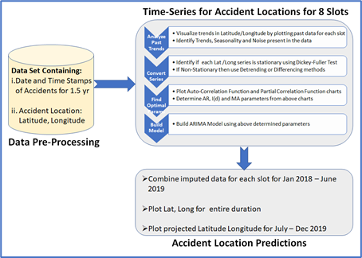
Solution Workflow – Approach 1
Time series concept is used to model crash data as time series and use ARIMA model to predict next crash location.
Filter data for 8 timeslots.
Segregate data to create different timeseries for latitude and longitude.
Find centroid for all accident locations for a specific timeslot on a given day. Repeat the same for all timeslots across the period.
Derive location centroids for each timeslot, individually for latitude and longitude.
Create train and test dataset from the above data.
Apply MSE / RMSE to derive accuracy on test set.
For every slot in each day, assign the centroid location to the 6 ambulances

Slide 7
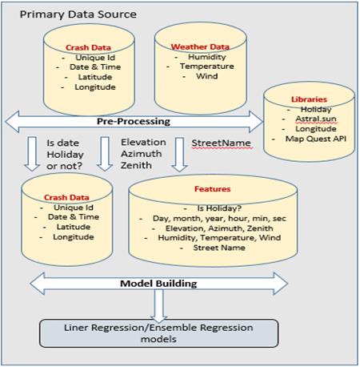
Solution Workflow – Approach 2
This approach is based on feature engineering and creating classifier to predict crash location.
The features used to build model are : latitude & longitude, date & time, weather data ( crash details given as part of challenge), derived features – day of week, is day off or not, is holiday or not, sun elevation
Create target label as Accident [ = 1, when accident happened, = 0 when accident did not happen ]. The given records, as part of challenge, (6318) will be marked as Accident=1
Create three new records for each record with Accident = 0, by replacing the time with three new times chosen randomly.
Split the entire dataset into Train and Test set.
Build classification model using different algorithms, check train and test accuracy.
Take future date, create features and generate random crash locations. Predict whether accident will happen or not at that location using the model built above.

Slide 8
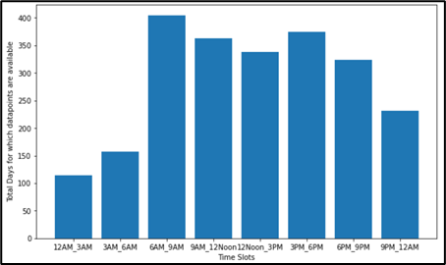
Data Processing & EDA – Solution Approach 1
The dataset was divided into 8 slots; 12-3AM, 3– 6AM, 6 – 9AM and so on.
Out of 545 days (1st Jan ‘18 to 30th Jun ’19), on an average data was available for 288 days. Missing data points were imputed using forward fill approach.
Data was further segregated to create two timeseries – one for latitude and the other for longitude.

Slide 9
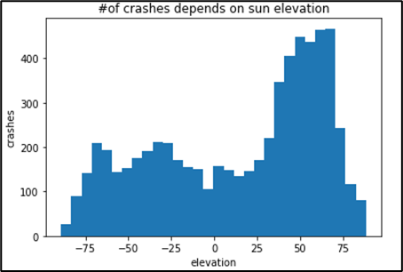
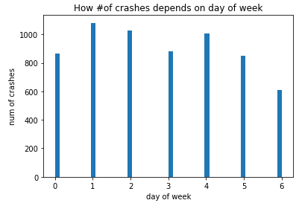
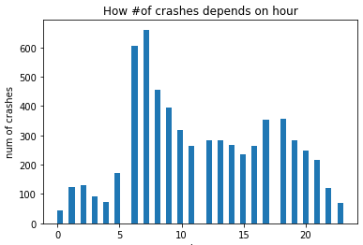
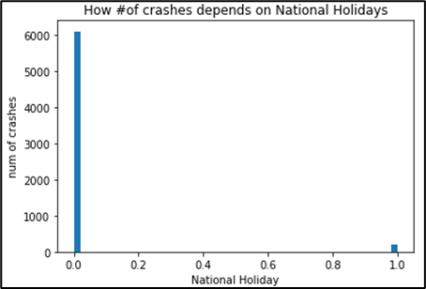
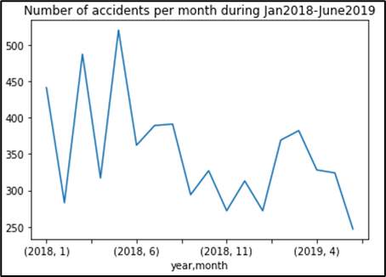
Data Processing & EDA – Solution Approach 2
The crash data was mapped with several parameters such as “Sun Elevation”, “Day of Week”, “Hour of Day”, “Whether Holiday”, “Month & Year”

Slide 10
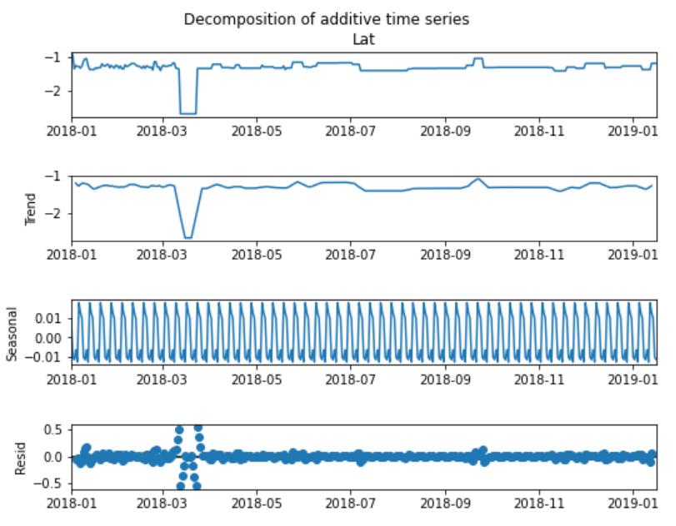
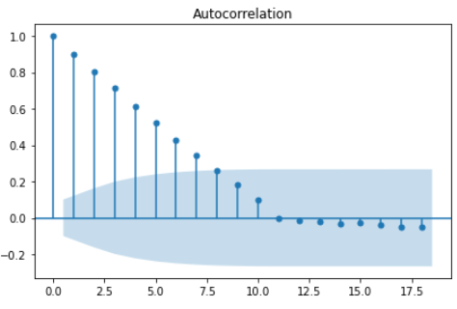
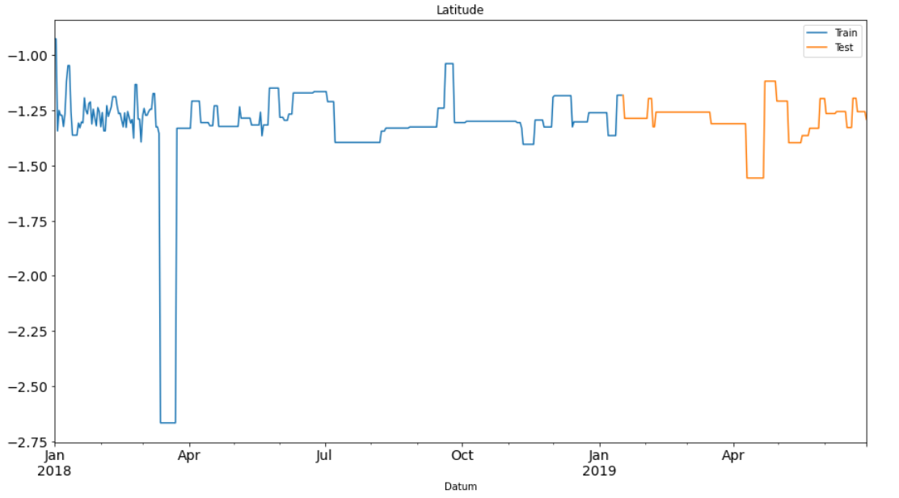
Models for Prediction – Solution Approach 1
Sixteen dataset suitable for timeseries model were created; eight for the latitude and eight for the longitude. Each series was plotted to observe Trend and Seasonality.
The stationarity of training data was evaluated through ADF test and p, d and q parameters were derived to be used in building ARIMA model
Further the data was segregated in training and test sets in 70:30 ratio.

Slide 11
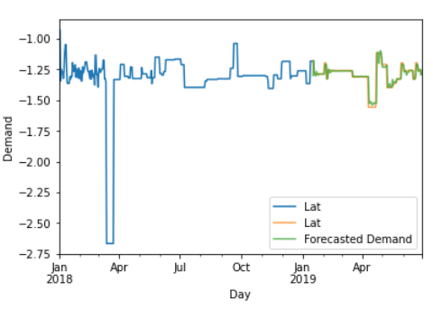
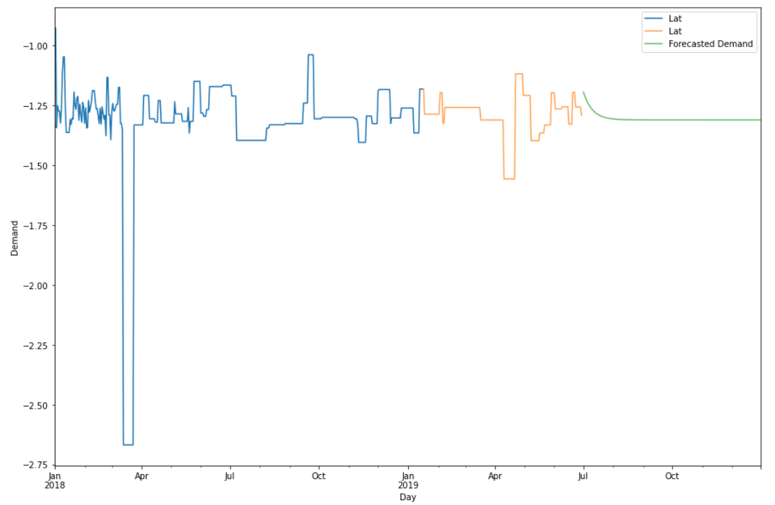
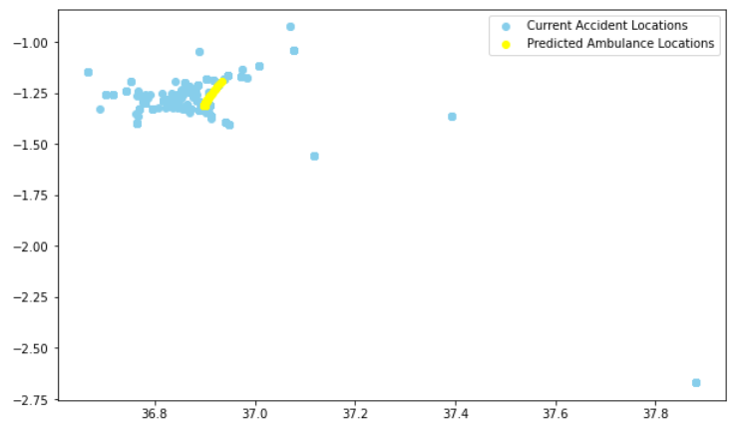
Models for Prediction – Solution Approach 1
ARIMA model was trained on the training data set. The accuracy of the model was verified through prediction on test set.
Once validated the trained ARIMA model was applied to forecast Latitude for the period of July 2019 – Dec 2019.
Similarly, longitude co-ordinates were also derived. The below figure shows the predicted ambulance locations in yellow against the backdrop of current accident co-ordinates.

Slide 12
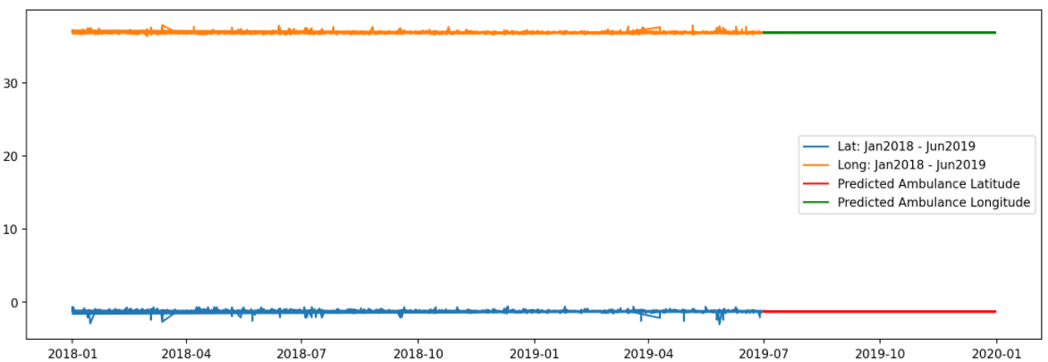
Models Metrics & Outcome – Solution Approach 1
Predictions for all 8 slots were derived for the period of July -Dec 2019. MSE and RMSE were derived for all ARIMA predictions. In total, 8 ARIMA models for Latitude and 8 ARIMA models for Longitude were developed and tested. The table below shows the summary of model performance for all 8 slots
The final result depicting ambulance locations for the entire period July – Dec 2019 is shown below. As observed the developed ARIMA models are highly accurate. However, sufficient data or benchmark is not available to compare the outcome of this study.
Slot | Latitude |  | Longitude
 | MSE | RMSE | MSE | RMSE
01: 12AM-3AM | 0.002 | 0.049 | 0.002 | 0.039
02: 3AM – 6AM | 0.003 | 0.057 | 0.003 | 0.058
03: 6AM-9AM | 0.005 | 0.071 | 0.006 | 0.077
04:9AM -12PM | 0.026 | 0.16 | 0.014 | 0.12
05:12PM -3PM | 0.006 | 0.075 | 0.006 | 0.076
06:3PM-6PM | 0.005 | 0.071 | 0.006 | 0.078
07:6PM-9PM | 0.039 | 0.197 | 0.016 | 0.128
08:9PM-12AM | 0.005 | 0.072 | 0.005 | 0.073

Slide 13
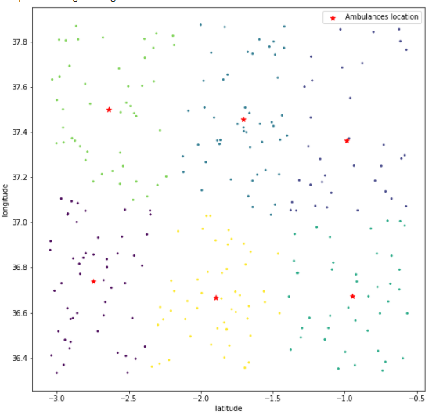
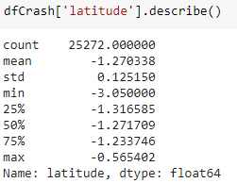
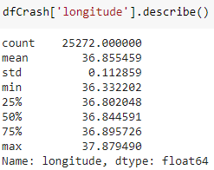
Models for Prediction – Solution Approach 2
The classification models using SVM, Random Forest & Dense network were built
Prediction for future date
Step-1: To predict accident on a future date, random crash locations were generated within the range based on training data. Latitude and longitude range of actual crash locations were considered to generate random locations.
Using model, predictions were made to identify whether accident will happen in those locations.
Step-2: For the predicted accident locations, KNN clustering model was used to create six locations for placing the ambulances.
Time Zone | No of accidents Predicted-SVM | No of accidents Predicted-Random Forest
12AM-3AM | 0 | 0
3AM-6AM | 44 | 89
6AM-9AM | 34 | 275
9AM-12PM | 5 | 3
12PM-3PM | 0 | 3
3PM-6PM | 0 | 4
6PM-9PM | 0 | 0
9PM-12AM | 0 | 0
Total | 83 | 374

Slide 14
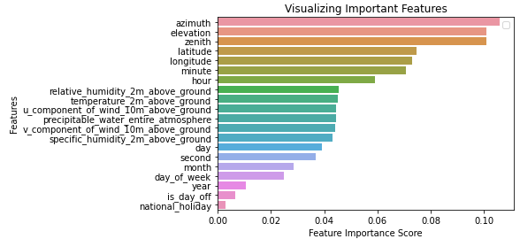
Models Metrics & Outcome – Solution Approach 2
Feature importance metrics
Model Evaluation Metrics
Training-Test Data | SVM | Random Forest | Dense Network
Accuracy (Test) % | 75.82 | 81 | 77.9
F1 Score % | 17.83 | 52 | 39
Test Precision % | 72 | 78 | 63
Test Recall % | 10 | 39 | 28

Slide 15
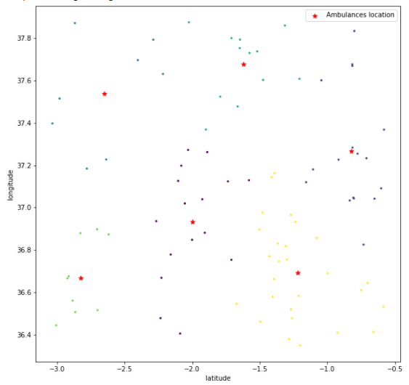
Models Outcome – Solution Approach 2
Accident Predictions (For Date: 05-Sep-19, for 3000 Records)
Ambulance Location for Time zone -3 using Random forest classifier
Ambulance Location for Time zone -2 using Random forest classifier
Ambulance Location For – Time zone 3
[-2.74473827, 36.73875905]
[-0.98552441, 37.36197124]
[-1.70586475, 37.45590102]
[-0.94985487, 36.67220806]
[-2.63965247, 37.50083687]
[-1.89652329, 36.66578275]
Ambulance Location For – Time zone 2
[-1.99900765, 36.93278538]
[-0.82084953, 37.26684971]
[-2.65011818, 37.54000612]
[-1.6222563 , 37.67812828]
[-2.82647136, 36.66900329]
[-1.21971844, 36.6930236 ]
Time Zone | No of accidents Predicted-SVM | No of accidents Predicted-Random Forest
12AM-3AM | 0 | 0
3AM-6AM | 44 | 89
6AM-9AM | 34 | 275
9AM-12PM | 5 | 3
12PM-3PM | 0 | 3
3PM-6PM | 0 | 4
6PM-9PM | 0 | 0
9PM-12AM | 0 | 0
Total | 83 | 374

Slide 16
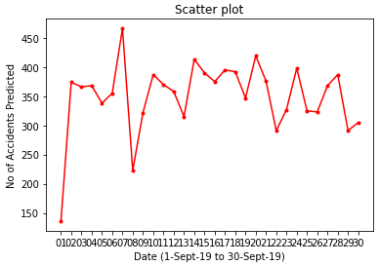
Models Outcome – Solution Approach 2…continued
Predictions for 1 month period
As demonstrated, this approach can be used to randomly generate thousands of crash locations and predict if accident can happen or not. Such crash location can be clustered and accordingly ambulance location can be set.

Slide 17
Q & A

